Slide 1
Large-scale statistical computing Hack-a-thon
17-18th March Atlanta

Slide 2
Agenda
Introduction Hack-a-thon
PatientLevelPrediction R-package
Track 1: Unit testing and continuous integration
Track 2: Code base improvements
Track 3: Learning Curves, search space reduction

Slide 3
Introduction
Peter R. Rijnbeek, PhD
Erasmus MC Rotterdam
The Netherlands

Slide 4
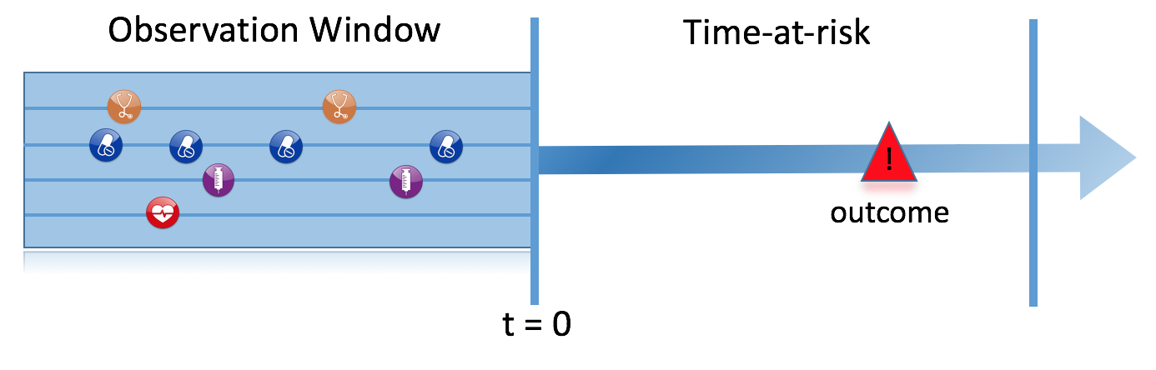
Work done in 2016
Full Patient History
1 Year
Outcome 1/22
First Pharmaceutically Treated Depression
Among patients in 4 different databases, we aim to develop prediction models to predict which patients at a defined moment in time (First Pharmaceutically Treated Depression Event) will experience one out of 22 different outcomes during a time-at-risk (1 year). Prediction is done using all demographics, conditions, and drug use data prior to that moment in time.
Full pipeline in R on top of the OMOP-CDM
Notes:
Let’s make our prediction problem more concrete.
Talk through the slide

Slide 5
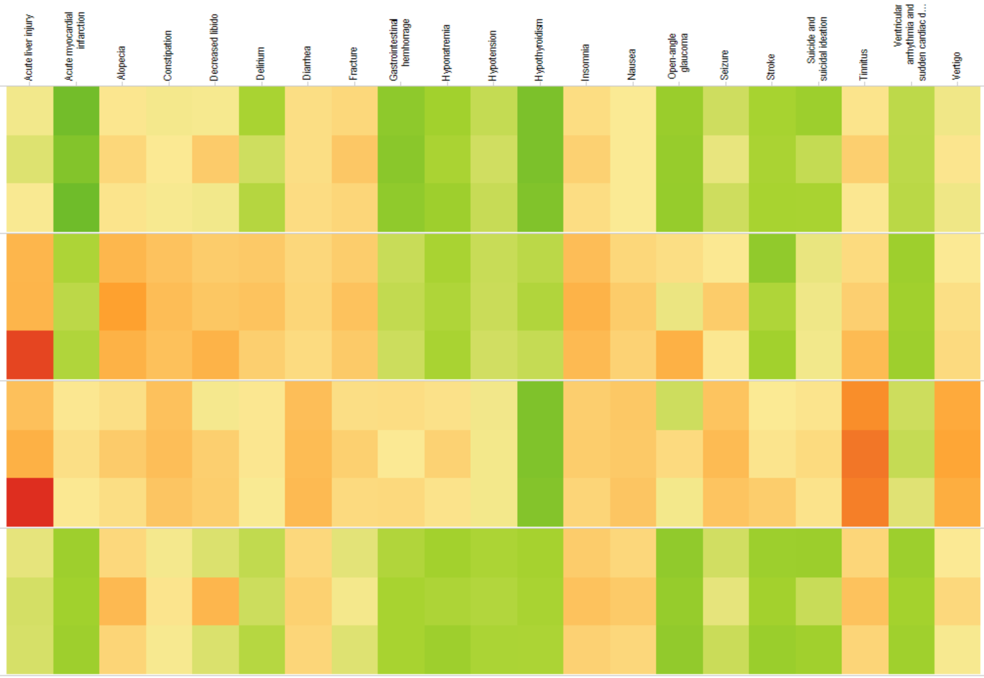
Model Discrimination
Outcomes
AUC
Gradient Boosting
1.00
CCAE
0.90
Random Forest
0.80
Regularized Regression
0.70
0.60
0.50
MDCD
MDCR
OPTUM
Notes:
Now let’s zoom out to all the outcomes over all the algorithms and all the databases.
We now see a column per outcome and each of the horizontal panels is a database and each row in a panel is an algorithm.
A lot of information in this colourfull picture. Let’s focus on some interesting aspects.
Models perform in general bad on the MDCR database compared to the others, except maybe for Hypothyroid…CHECK NAME. The MDCR databases contains in genarally older patients with more co-morbidities which could mean that it is harder to discriminate.

Slide 6
Model Discrimination
AMI
Diarrhea
Hypothyroidism
Nausea
Stroke
AUC
1.00
CCAE
0.90
0.80
0.70
There are no major differences among the algorithms
0.60
0.50
MDCD
Some outcomes we can predict very well some we cannot
MDCR
OPTUM
Notes:
Now let’s zoom out to all the outcomes over all the algorithms and all the databases.
We now see a column per outcome and each of the horizontal panels is a database and each row in a panel is an algorithm.
A lot of information in this colourfull picture. Let’s focus on some interesting aspects.
Models perform in general bad on the MDCR database compared to the others, except maybe for Hypothyroid…CHECK NAME. The Medicare databases contains in genarally older patients with more co-morbidities which could mean that it is harder to discriminate.

Slide 7
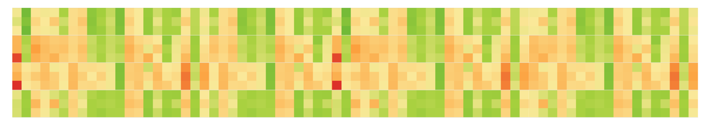
What do we want to do in 2017?
Scale up: more cohorts of interest, more outcomes, (on more databases)
Extend: feature engineering, addition of models etc.
Do we need to spend much effort in less promising prediction problems?
Cherry pick the prediction problems of interest

Slide 8
Goals of the Hack-a-thon
Give hands-on experience to our users
Improve the code base (unit testing, code optimization etc.)
Extend the pipeline with advanced feature engineering and other algorithms
Study how to reduce the search space without loss in predictive power

Slide 9
Agenda
Introduction Hack-a-thon
PatientLevelPrediction R-package
Track 1: Unit testing and continuous integration
Track 2: Code base optimization
Track 3: Learning Curves, search space reduction

Slide 10
PatientLevelPrediction R-package
Jenna Reps, PhD
Janssen Research and Development

Slide 11
Slides and Code Explanation Jenna

Slide 12
Track 1: Unit testing and continuous integration
Marc Suchard, PhD
UCLA

Slide 13
Slides Marc?

Slide 14
Track 2: Code base optimization
Jenna Reps, PhD
Janssen Research and Development

Slide 15
Slides Jenna

Slide 16
Track 3: Learning curves and search space reduction
Peter Rijnbeek, PhD
Erasmus MC, Rotterdam
The Netherlands

Slide 17
Data extraction
What type of data do we actually need?
Do we need all conditions, measurements, prescriptions etc. or can we take a sequential approach (start with conditions?)
Can we grow the lookback period?
Experiment: How different would our conclusions be in the POC if we would have only run this on conditions? How much speed would we have gained in the full pipeline?
Develop a study protocol to get more insight
Develop the code for the study

Slide 18
Data partitioning
How much data do we actually need for training and evaluating the models?
Can we do incremental learning, i.e. start with a smaller set and only scale up if this shows increased performance?
Experiment: take different percentages of the data and compare the performance (learning curve) -> we need code for this to happen!
Develop a study protocol to increase our insight (on a large set of problems)
Implement learning curves

Slide 19
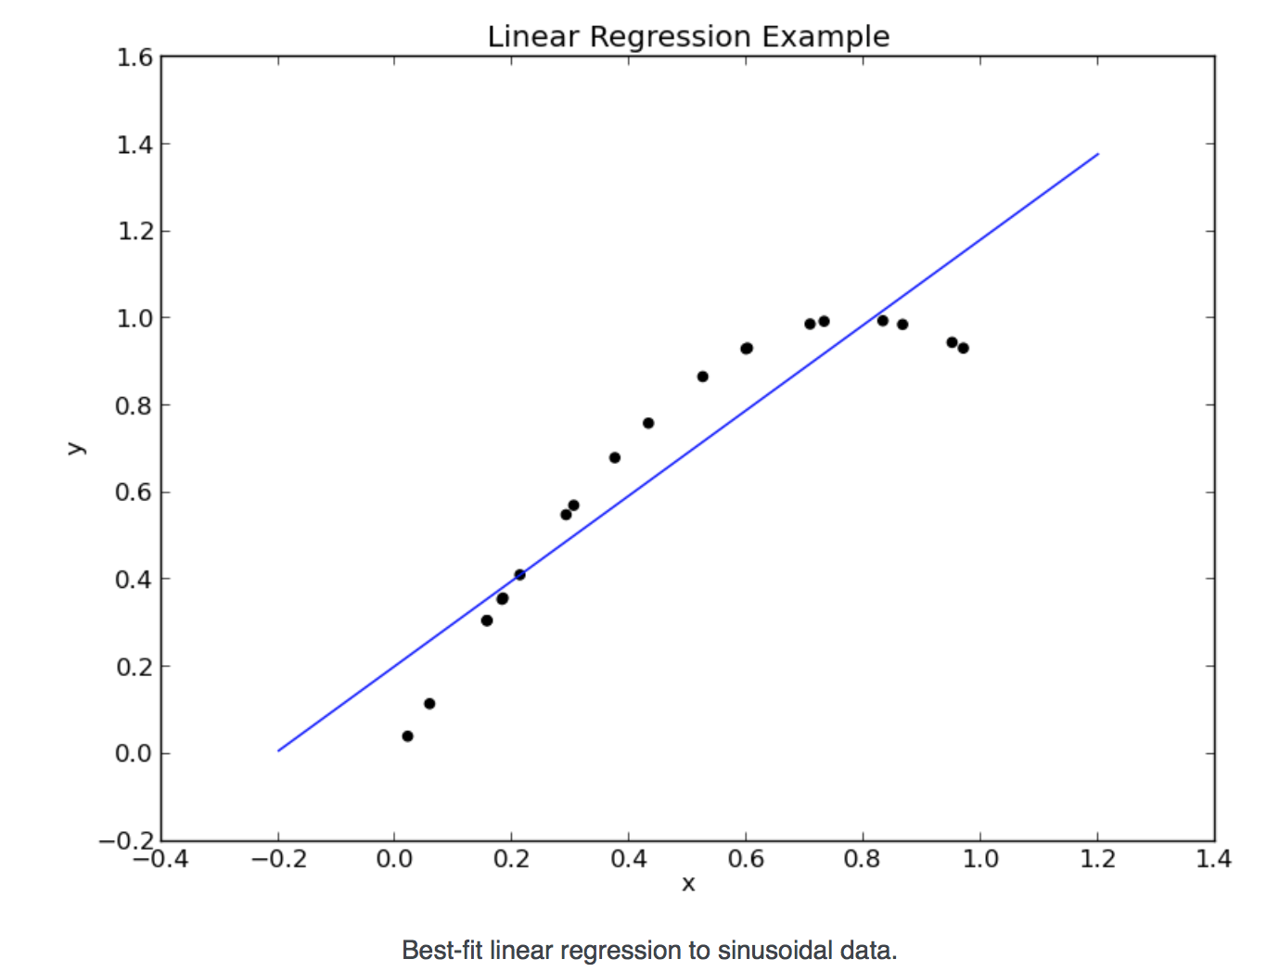
Background Learning Curves
Question: What is the effect of the training set size on the performance of the models?
To improve the fit we can:
Increase the number of training points N. This might give us a training set with more coverage, and lead to greater accuracy
Increase the degree d of the polynomial. This might allow us to more closely fit the training data, and lead to a better result
Add more features/ complexity, e.g. 1/x
d=1-> High bias

Slide 20
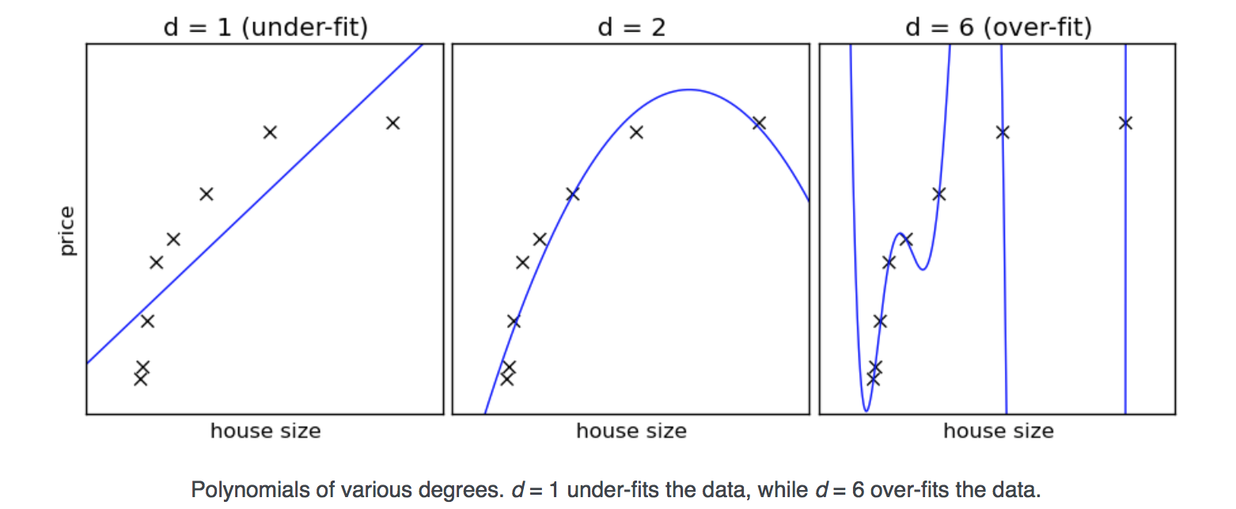
Background Learning Curves

Slide 21
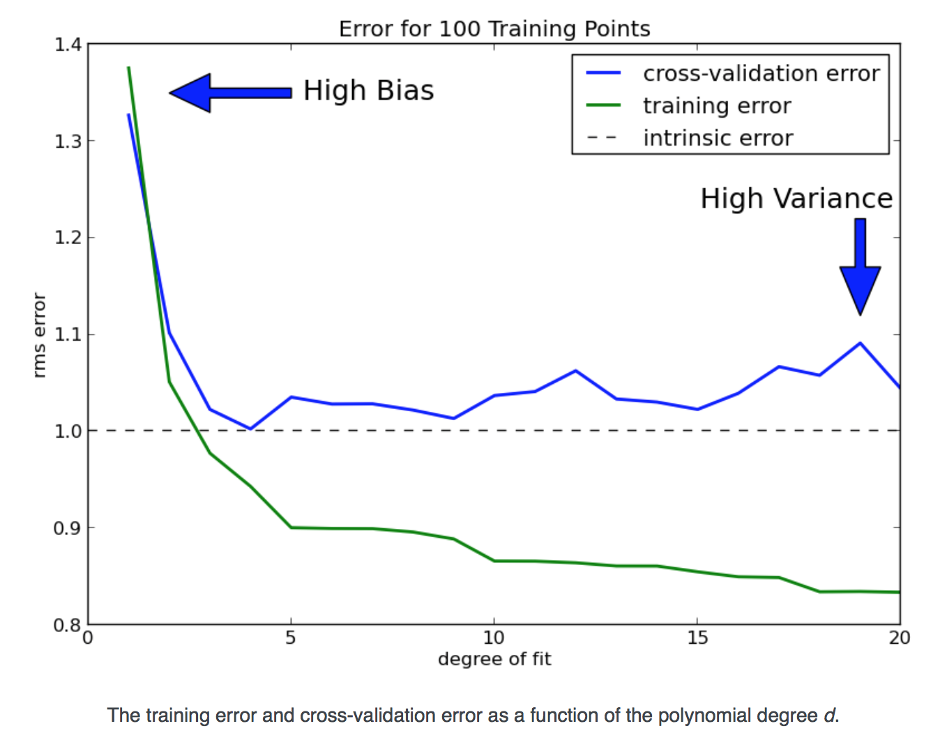
Background Learning Curves
Now d=6 is performing much better than d =2?
Rule of thumb:
The more data points the more complicated model can be used.
Question: But how much is really needed?

Slide 22
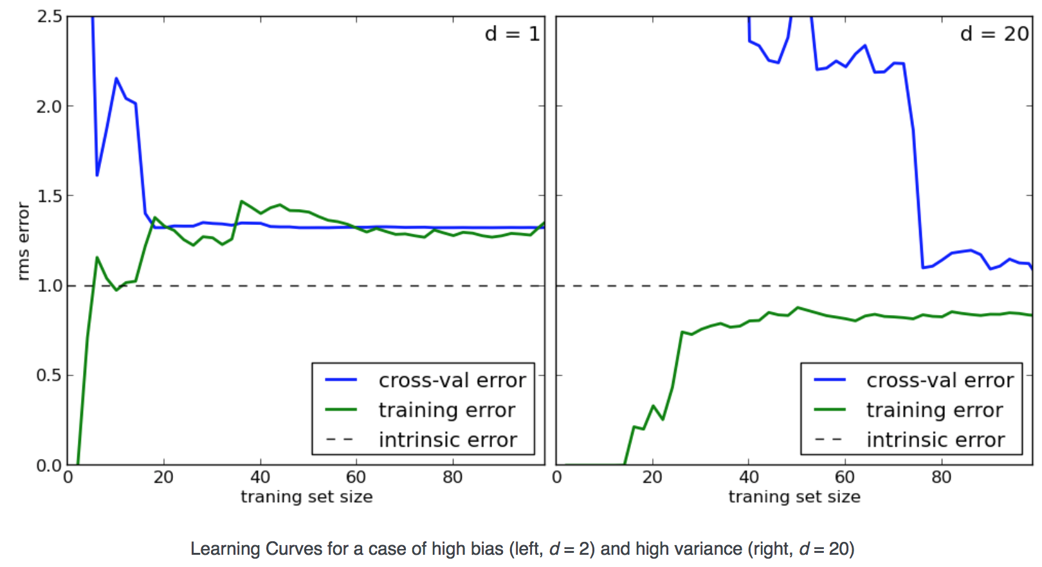
Learning Curves
High Bias - > adding data does not help
High Variance ->
Converge to intrinsic error

Slide 23
Learning Curves
Give insight in the bias and variance of the model
Is helpful to determine if getting more data is useful (costly data).
Progressive sampling: start with a very small batch of instances and progressively increase the training data size until a termination criteria is met.

Slide 24
Learning Curves in Big Data for predictive modelling
We probably sometimes have the problem we have too much data which increases the computation time too much. Do we need more data? Do we need to make the models more complex to reduce the bias?
A possible focus of a paper could be to define a strategy for this, e.g. by showing that if we have more than X persons more data will not help? This will depend on the prevalence of the outcome probably etc.
We want to create learning curves for a set of benchmark problems.
We want to do this for different type of models/algorithms using our current PLP Package

Slide 25
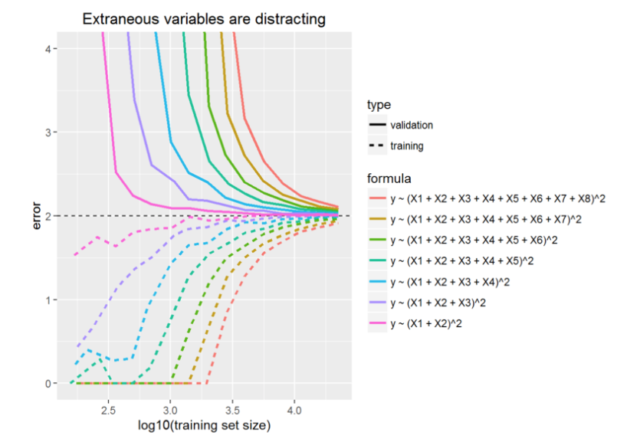
Example in R
Simulation experiment with interaction between X1 + X2.
Code is available from www.github.com/mi-erasmusmc/Hack-A-Thon
See Bob Horton : http://blog.revolutionanalytics.com/2016/03/learning-from-learning-curves.html

Slide 26
Model learning
Which type of algorithms will be included and can these be further improved?
We could start by taking the fasted approach (probably lasso) and only do the others if the performance is above a certain level. We could automate this.
Can we transfer knowledge between prediction problems? How?

Slide 27
Practicalities
We have created a github with some useful scripts you can clone:
https://github.com/mi-erasmusmc/Hack-a-thon
We have access to the SYNPUF dataset (1000k and 1pct) to use for testing etc. (see github)
We can run on real databases in a second phase

Slide 28
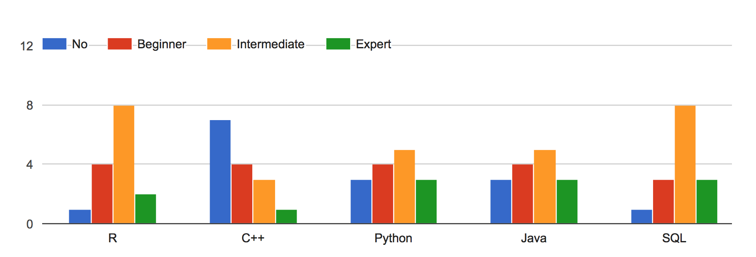
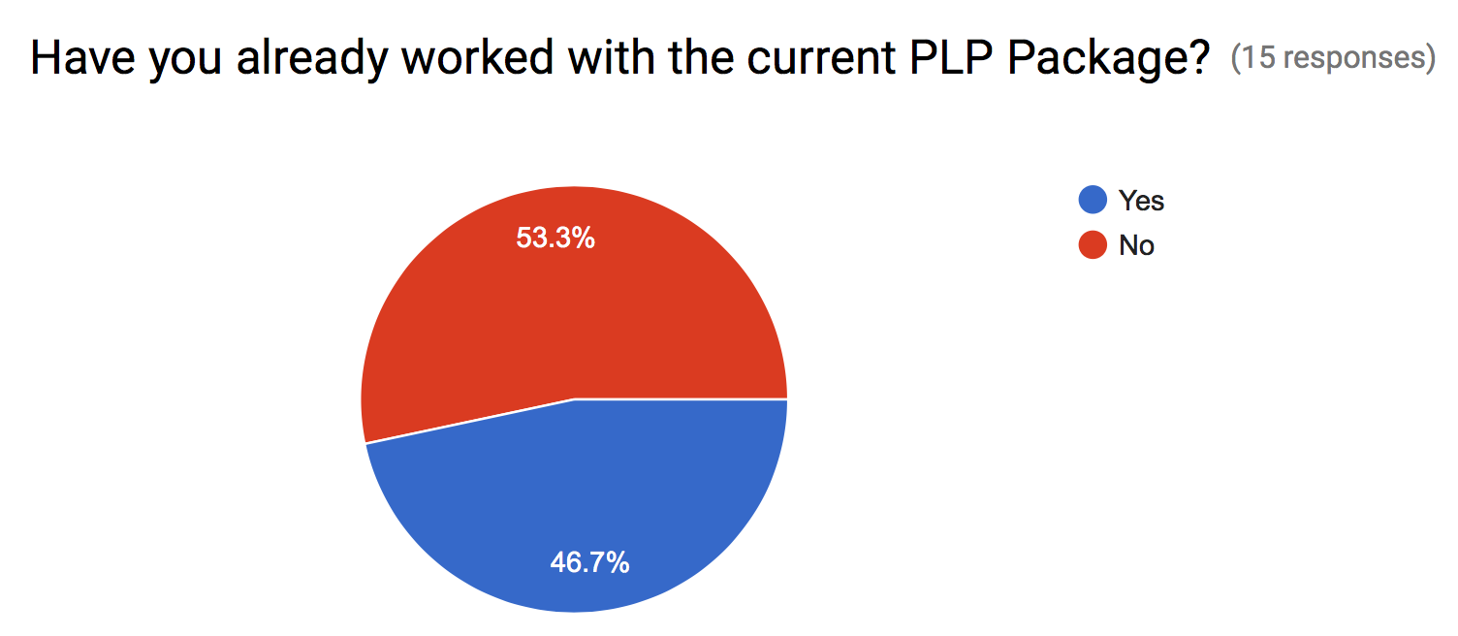
The Hack-a-thon team https://goo.gl/forms/uUqZ2Ecxq2ymPf2d2

Slide 29
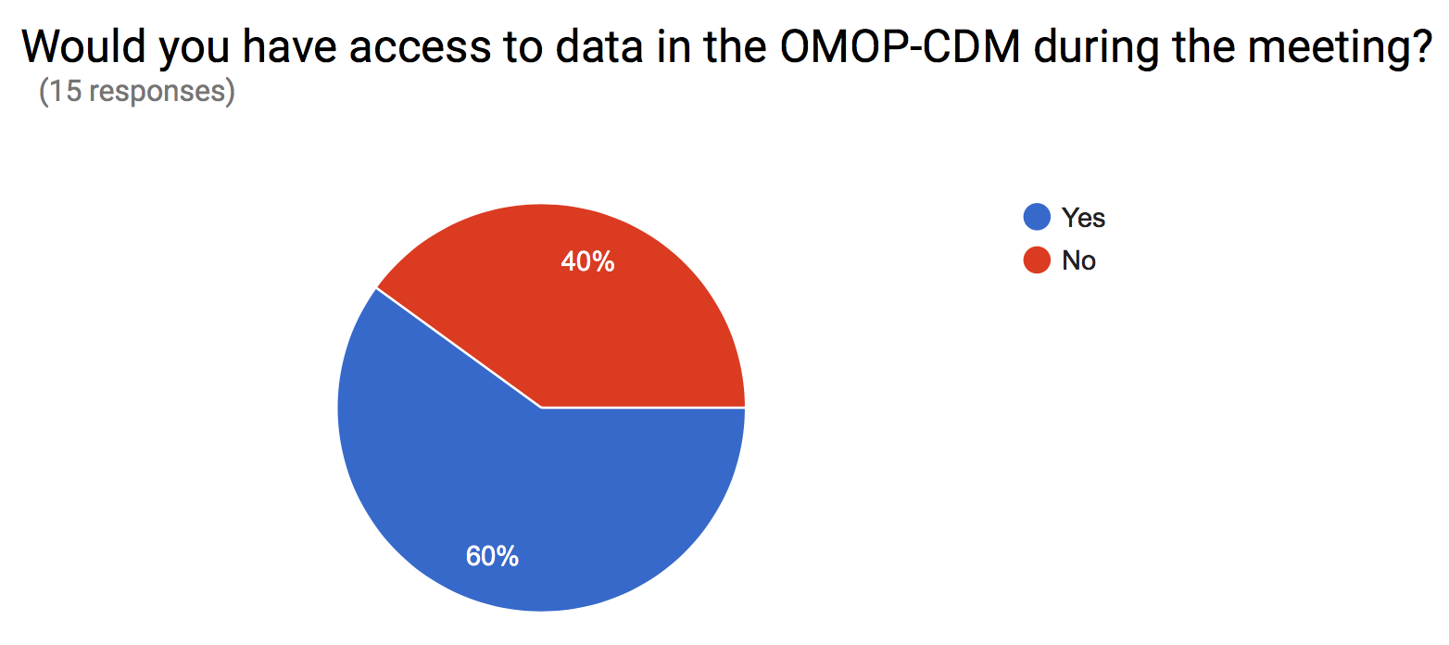
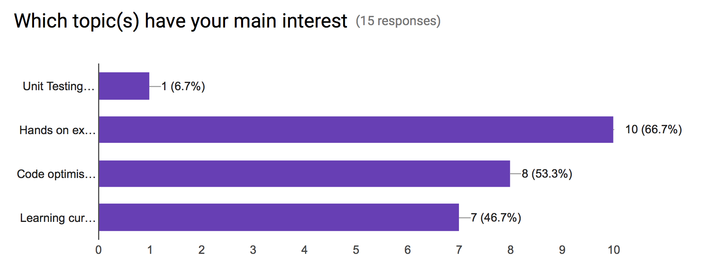
The Hack-a-thon team https://goo.gl/forms/uUqZ2Ecxq2ymPf2d2

Slide 30

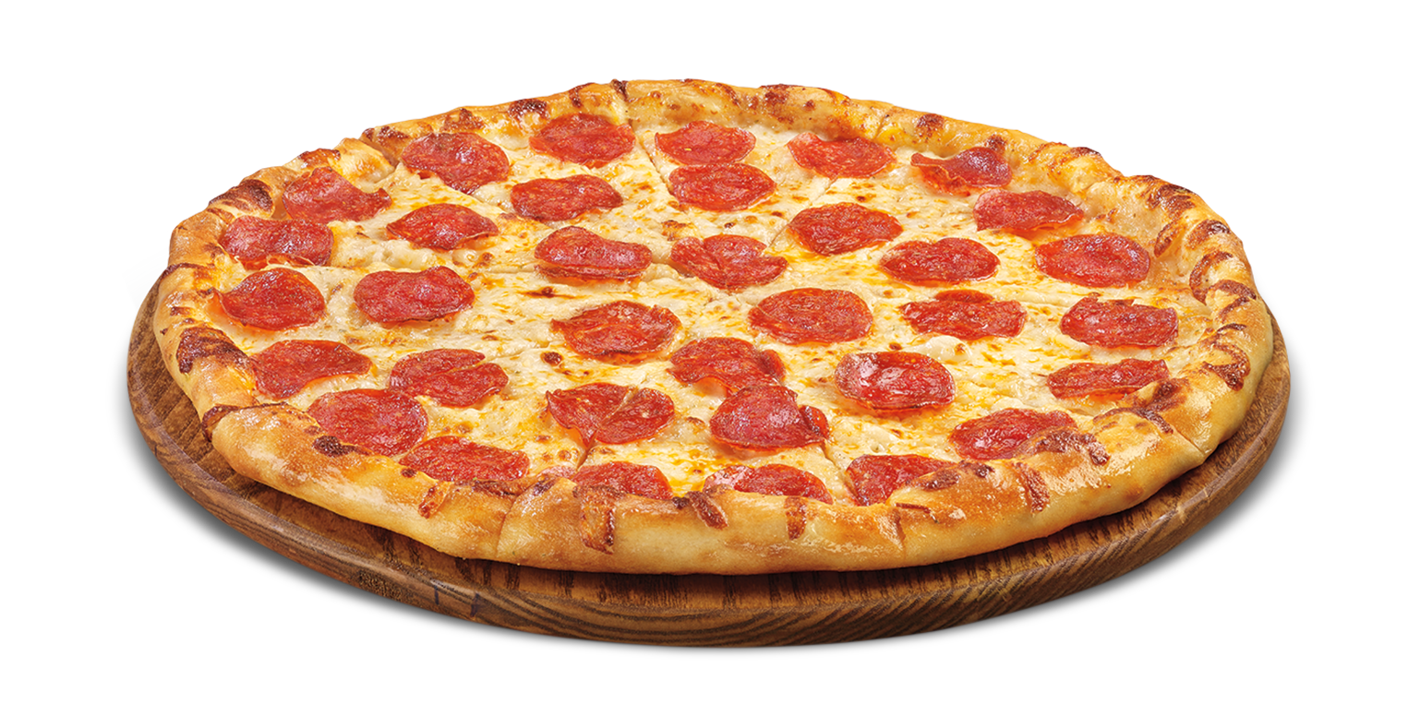
Dinner option…?

